Slide 1


Universal Language Model Fine-Tuning for Text Classification
1
Capstone Project Phase 2
Supervisors:
Dr. Renata Avros
Prof. Vladimir (Zeev) Volkovich
Group members:
Bradley Feitsvaig
Aviv Okun

Slide 2
Agenda
2
The Problem
DESKTOP APP
Conclusions
The Solution
Evaluation and Verification Plan

Slide 3

What is Natural Language Processing?
3
Subfield of linguistics and artificial intelligence.
Focuses on the interaction between computers and human language.
Speech recognition, natural language understanding, and natural language generation.

Slide 4

The Problem
01
4

Slide 5
01
03
02
04
5
Neural network models usually deals with a single task.
Training a model from scratch requires large amounts of resources.
There is a need for a single model that can switch between tasks
Training a model from scratch consumes time.

Slide 6
The Solution
02
6

Slide 7
ULMFiT
7
General domain pretraining
Stage 1
Stage 2
Target task language model fine tuning
Target task classifier fine tuning
Stage 3

Slide 8

In Our System
8
English Model
Russian Model
Trained to analyze sentiment for Twitter US Airlines, using wikitext-2 as a dataset for fine tuning the model.
Trained to perform authorship detection for books by Mikhail Sholohov. The model uses the book “And Quiet Flows The Don” as a dataset for fine tuning the model.
Both models uses Language-Agnostic BERT Sentence Embedding (LaBSE) for the word embedding layer because it can encode words and sentences from different languages to a shared embedding space.

Slide 9
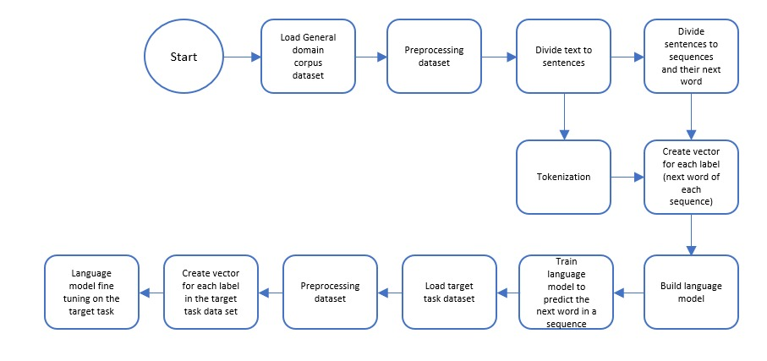
Flow Chart Of the System
9

Slide 10
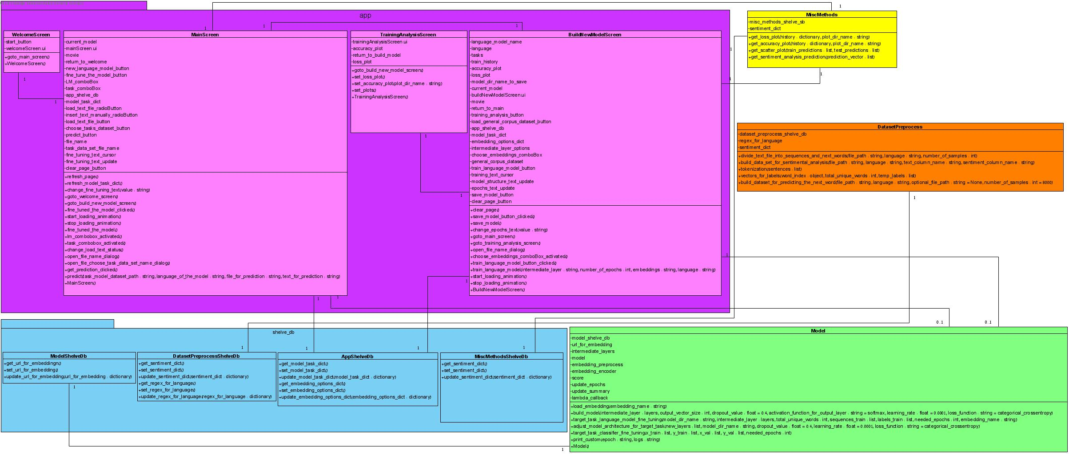

Slide 11



System Developed With
TensorFlow
Keras
pyqt5
10
High-level deep learning API
Open source platform for machine learning
Module for building apps in python

Slide 12
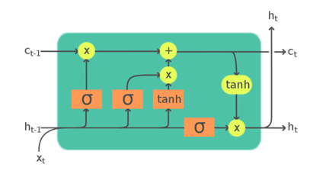
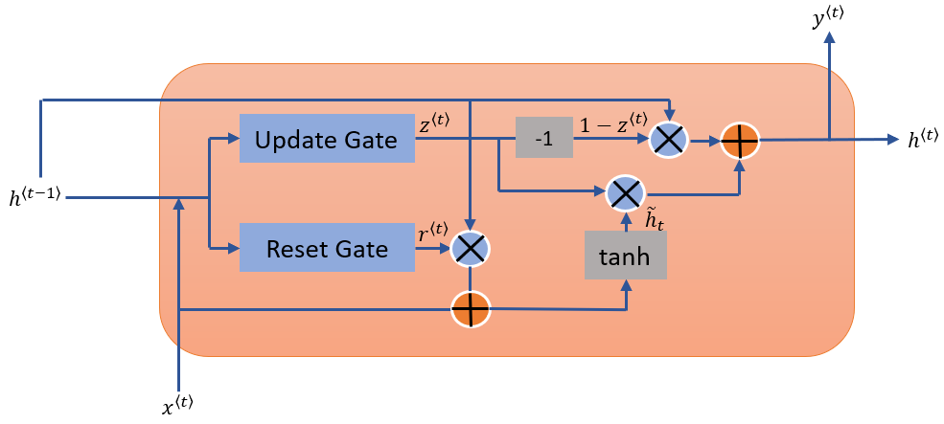
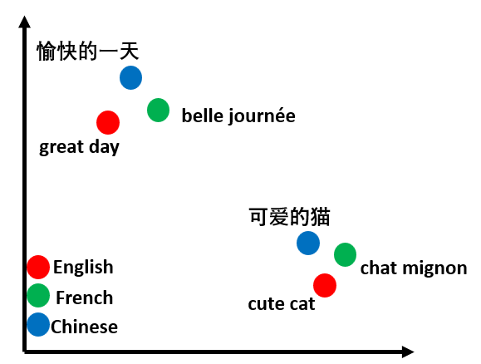
System Developed With
LSTM
GRU
LaBSE
11
Gated Recurrent Unit
Long-Short-Term memmory
Language-Agnostic BERT Sentence Embedding

Slide 13
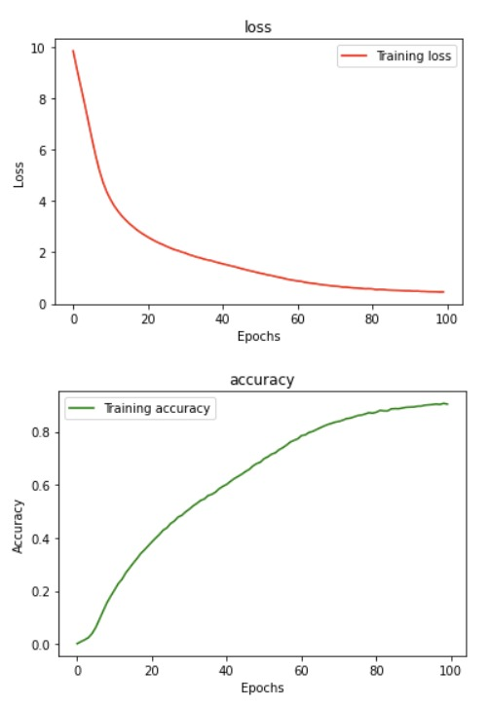
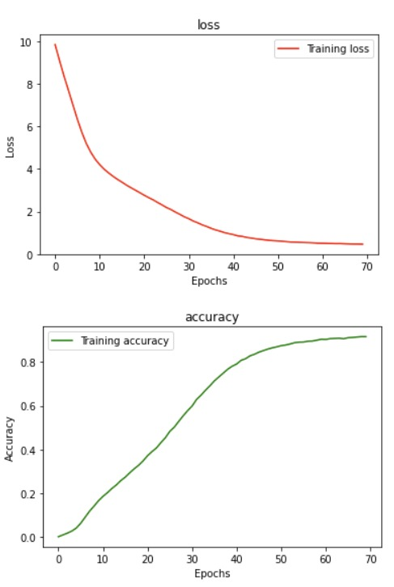
Results
12
English Model
LSTM
GRU
Fine-Tuning

Slide 14
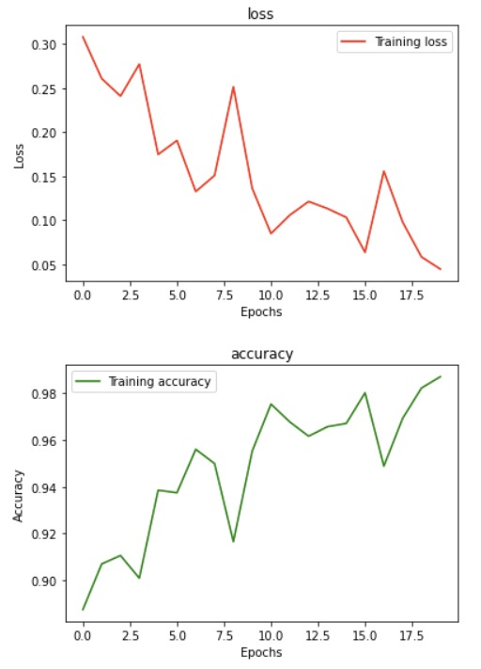
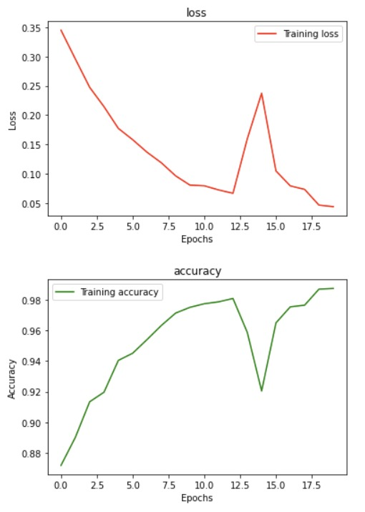
Results
13
English Model
LSTM
GRU
Target Task Classifier

Slide 15
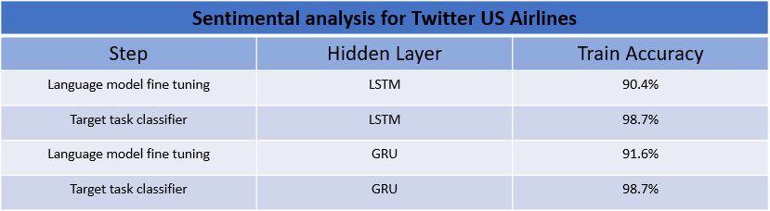
Results
14
English Model

Slide 16
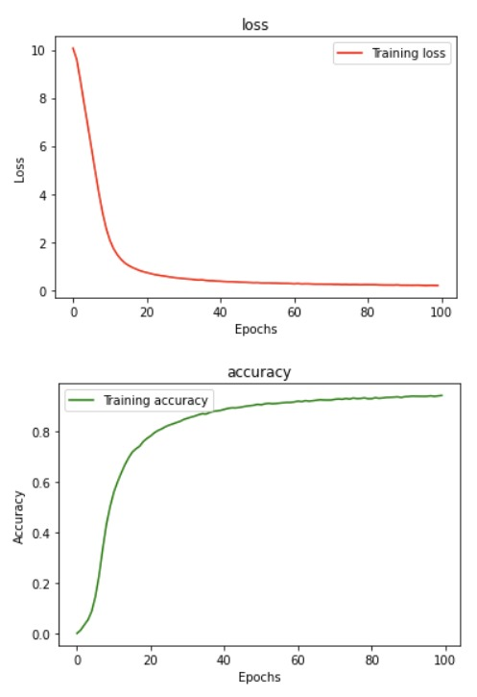
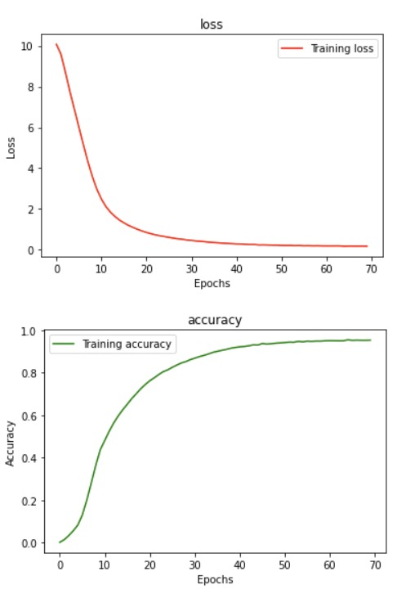
Results
15
Russian Model
LSTM
GRU
Fine-Tuning

Slide 17
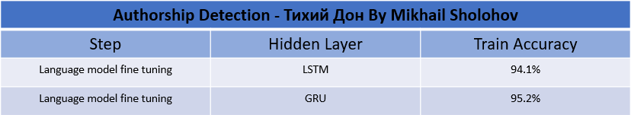
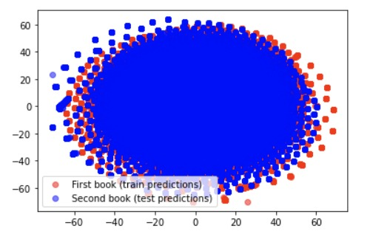
Results
16
Russian Model

Slide 18
DESKTOP APP
03
17

Slide 19
DESKTOP APP
18
ULMFiT research tool

Slide 20
Evaluation and Verification Plan
04
20

Slide 21
Evaluation and Verification Plan
21
Black Box Testing
white box
functional testing
unit tests with python unit-test library

Slide 22
Black Box Testing
22
Functional testing

Slide 23
Getting prediction from text functionality
23
(1) sentiment analysis prediction variations were tested by altering the model input for prediction for both "English with LSTM wiki2" and "English with GRU wiki2" models.
Case | Input | Results
A – positive sentence | "you are one great airline" | POSITIVE
B – negative sentence | "how about starting without the robotic response?" | NEGATIVE
C – neutral sentence | "I sent in my feedback" | NEUTRAL
D – input failure | No input | "You have to insert text or load text file to get prediction"

Slide 24
Getting prediction from text functionality
24
(2) The authorship analysis is tested by using different books by Mikhail Sholokhov as an input and the cluster formulation is examined.
Case | Input | Results
A | "And quiet flows the don 2" | 2 different clusters, 1 for the training book " And quiet flows the don 1" and the second for the input book.
B – input failure | No input | "You have to insert text or load text file to get prediction"

Slide 25
(3) Training new language model functionality
25
Case | Input | Results
Case A | All parameters are filled properly. | Training process is shown on the lower half of the window.
Case B | Not all parameters are filled properly. | GUI displays an error message: "You have to fill all parameters for the new language model"
(4) fine tuning a language model functionality.
Case | Input | Results
Case A | All parameters are filled properly. | Training process is shown on the lower half of the window.
Case B | Not all parameters are filled properly. | GUI displays an error message: "You have to fill all parameters for the fine tuning"

Slide 26
White box Testing
26
Unit test

Slide 27
Dataset preprocessing tests functions
27
Class under test: dataset_preprocess
Test name | Method under testing | Description | Result
test_divide_text_file_into_sequences_and_next_words | divide_text_file_into_sequences_and_next_words | checks if the number of sequences is equal to the number of labels after dividing the raw text. | pass
test_build_data_set_for_sentimental_analysis | build_data_set_for_sentimental_analysis | checks if the number of sentiment sentences is equal to the number of labels and there are exactly 3 classes of predictions. | pass
test_vectors_for_labels | vectors_for_labels | checks if the returned value is of type "list". | pass
test_build_dataset_for_predicting_the_next_word | build_dataset_for_predicting_the_next_word | checks if the number of sequences is equal to the number of labels after building the dataset for training the model. | pass

Slide 28
Main screen testing (app.py)
28
Class under test: MainScreen
Test name | Method under testing | Description | Result
test_refresh_page | refresh_page | checks that the window is returned to the default state after pressing the clear button | pass
test_refresh_model_task_dict | refresh_model_task_dict | checks if the LM_comboBox displays all the available language models in the system. | pass
test_start_loading_animation | start_loading_animation | checks if at the start of a GUI operation the relevant widgets are disabled | pass
test_stop_loading_animation | stop_loading_animation | checks if at the start of a GUI operation the relevant widgets are enabled. | pass
test_task_combobox_activated | task_combobox_activated | checks if the model task combo box is displaying only the relevant tasks according to the selected model. | pass

Slide 29
Main screen testing (app.py)
29
Class under test: BuildNewModelScreen
Test name | Method under testing | Description | Result
test_clear_page | clear_page | checks that the window is returned to the default state after pressing the clear button | pass
test_choose_embeddings_combo_box_activated | choose_embeddings_combo_box_activated | checks if the choose language combo box is displaying only the relevant languages according to the selected embedding. | pass
test_stop_loading_animation | stop_loading_animation | checks if at the start of a GUI operation the relevant widgets are disabled | pass
test_stop_loading_animation | stop_loading_animation | checks if at the start of a GUI operation the relevant widgets are enabled. | pass

Slide 30
Conclusions
05
30

Slide 31
Hardware limitation
Unfeasible methods
31
Challenges
Building a new LM requires High-quality computer hardware.
By using Keras, some of the methods in ULMFiT are unfeasible.

Slide 32
Fine Tuning
Different languages
01
03
Switch tasks
ULMFiT research tool
02
04
32
Achievements
Fine-tuned the language model according to ULMFiT algorithm.
Build a langugae model for different languages with the same components.
Switch between NLP tasks without build and training a new LM from scratch.
Desktop application for research the ULMFiT algorithm on different LM with different components and parameters.

Slide 33
34
THANKS!
Do you have any questions?

